Slide 1
LECTURE 0
INT 306
Database Management System

Slide 2
HOURS AND CREDIT
L T P: 302
CREDIT: 4

Slide 3
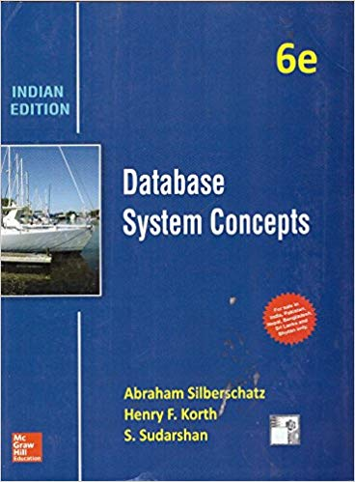
TEXT BOOK TO STUDY
DATABASE SYSTEM CONCEPTS by HENRY F. KORTH, ABRAHAM SILBERSCHATZ, S. SUDARSHAN, MCGRAW HILL EDUCATION

Slide 4

Text book and reference book
Text Books:
DATABASE SYSTEM CONCEPTS by HENRY F. Korth, Abraham Silberschatz, S. Sudarshan, Mcgraw Hill Education
References:
THE PROGRAMMING LANGUAGE OF ORACLE by Ivan Byross, BPB Publications
DATABASE SYSTEMS: MODELS, LANGUAGES, DESIGN AND APPLICATION PROGRAMMING by Ramez Elmasri, Shamkant B. Navathe, Pearson
AN INTRODUCTION TO DATABASE SYSTEMS by C. J.Date, S. Swamynathan, A. Kannan, Pearson

Slide 5
Complete evaluation criteria for the course
CA1: 30 marks- Test-1
CA2: 30 marks- Test 2
CA3: 30 marks- BYOD Practical
(BEST 2 out of 3)
Mid Term- MCQs based
End Term- MCQs based

Slide 6
The BURNING questions in mind…
Why are we learning Database MANAGEMENT SYSTEMS ?

Slide 7
Difference Between Data and Information ?
Data is an individual unit that contains raw material which does not carry any specific meaning.
Information is a processed, organised data presented in a given context and is useful to humans.
Information is a group of data that collectively carry a logical meaning.
KNOWLEDGE ?

Slide 8
KNOWLEDGE
knowledge (of about something) information, understanding and skills that you have gained through learning or experience
the state of knowing about a particular fact or situation

Slide 9
Dataset and database
A dataset is a structured collection of data generally associated with a unique body of work.
A database is an organized collection of data stored as multiple datasets

Slide 10
ANSWER THIS
HOW MANY USERS ARE THERE ON FACEBOOK ?
HOW MUCH TIME WILL IT TAKE TO WATCH ALL VIDEOS ON YOUTUBE ?
HOW MANY TRANSACTION PER MINUTE ARE DONE ON AMAZON DURING
DIWALI SALES ?
DO WE HAVE INFINITE STORAGE ?

Slide 11

World is full of information

Slide 12
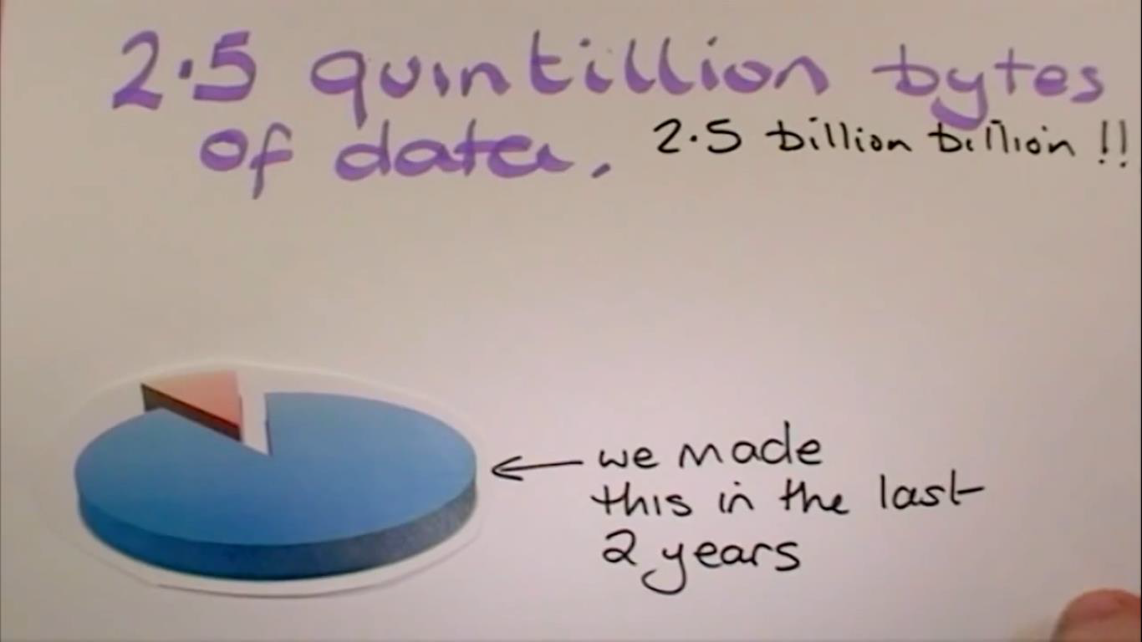

Slide 13
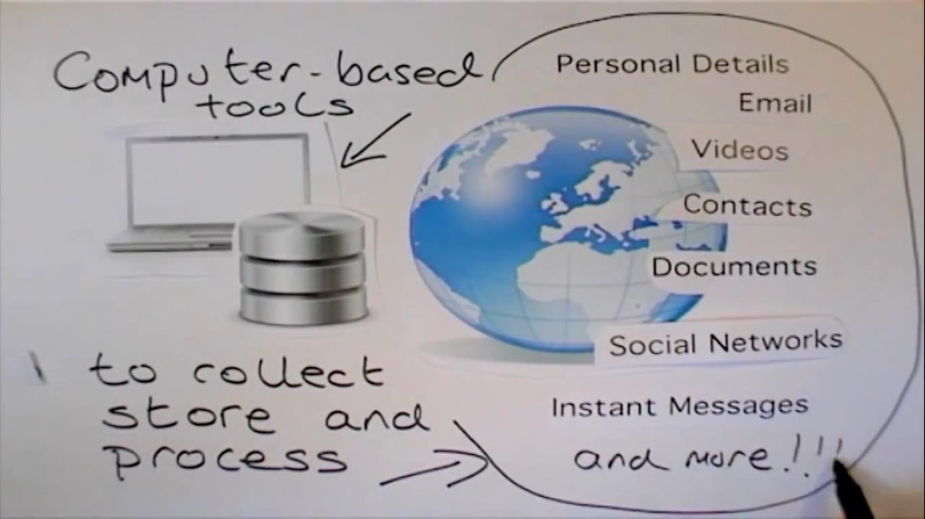
Information systems

Slide 14
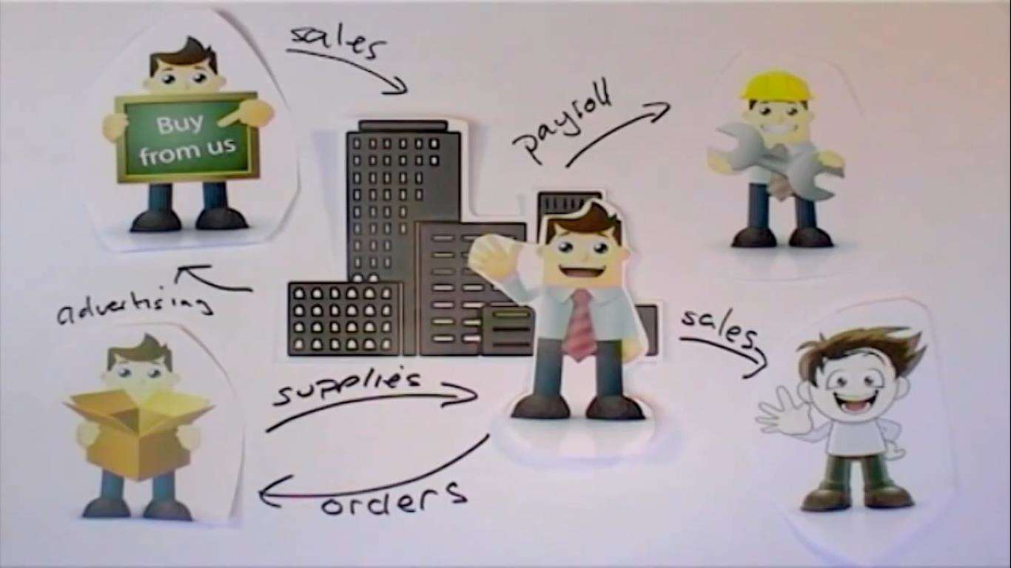

Slide 15
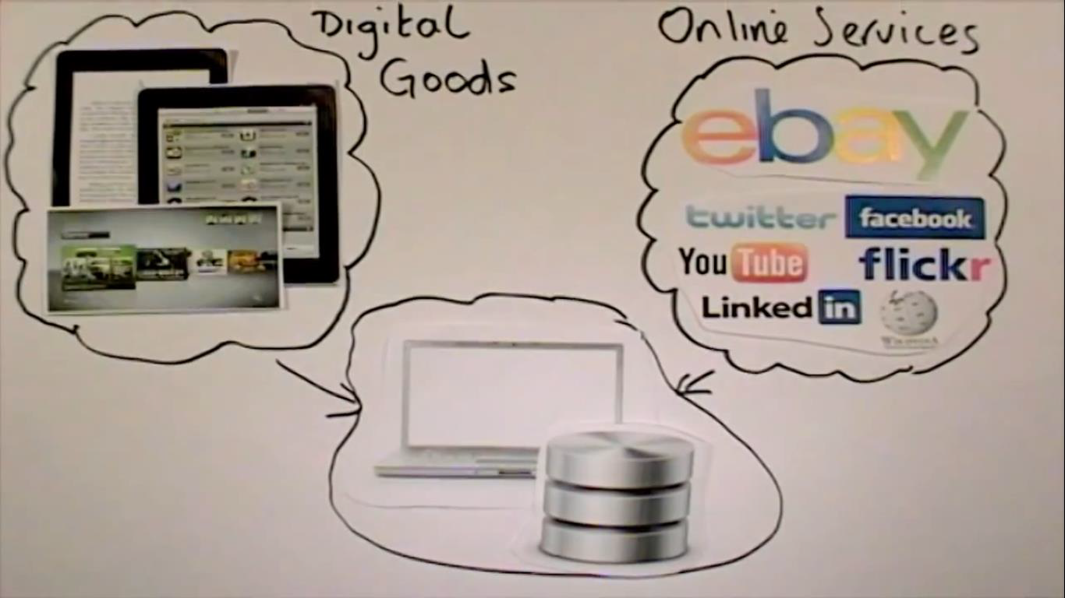

Slide 16
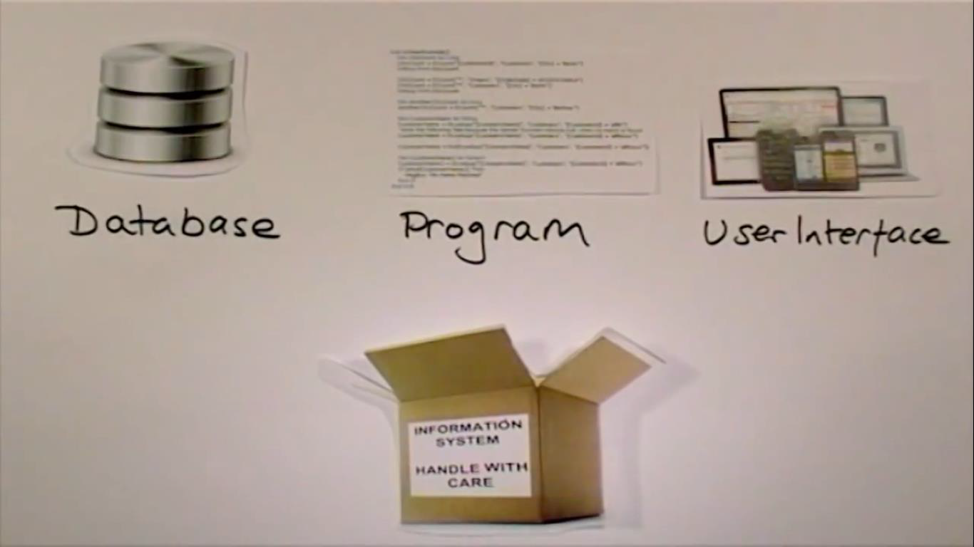
Composition

Slide 17
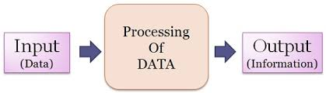
Data and information
Raw material that can be processed by any computing machine is information.
Images, words, numbers , sounds etc. all forms different representations of the data.

Slide 18
Database
A database is actually a place where related piece of information is stored and various operations can be performed on it.
we can say database is a shared collection of logically related data in a systematic manner

Slide 19
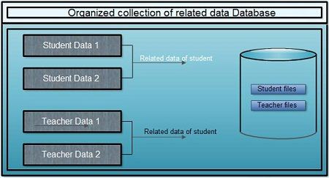
Database

Slide 20
Introduction to DBMS
DBMS=Database Management System
Database+Management+System
In which the database is managed by the system.
Database Management System
Database+Management System
collection of data is a set of program to store &
retrieve the data.

Slide 21
A DBMS is a software(or a collection of programs) that enables users to store modify and extract information from a database as per the requirements.
DBMS is actually a tool that is used to perform any kind of operation on data in database.
Some DBMS examples:
MySQL
Oracle
My SQL server
IBM DB2

Slide 22
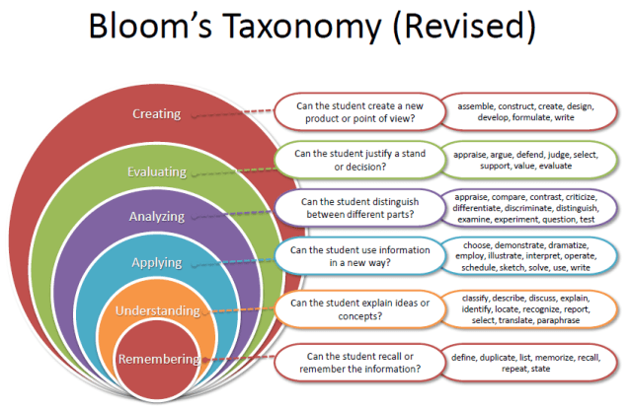
Revised Bloom’s Taxonomy

Slide 23
Course Outcome
CO1 :: explain the Database components and logical design of databases
CO2 :: practice relational constructs like algebra, constraints and SQL
CO3 :: possess knowledge on the different issues involved in the design and implementation of relational database system
CO4 :: learn the transaction management systems in single and concurrent environment
CO5 :: practice programming constructs such as functions, stored procedures and triggers that can be shared by multiple forms
CO6 :: discuss file organization techniques, reports and data management applications

Slide 24
Program Outcomes
PO1 Engineering Knowledge:: Apply the knowledge of mathematics, science, engineering fundamentals, and an engineering specialization to the solution of complex engineering problems.
PO2 Problem Analysis:: Identify, formulate, research literature, and analyze complex engineering problems reaching substantiated conclusions using first principles of mathematics, natural sciences, and engineering sciences.
PO3 Design/development of solutions:: Design solutions for complex engineering problems and design system components or processes that meet the specified needs with appropriate consideration for the public health and safety, and the cultural, societal, and environmental considerations.
PO4 Conduct investigations of complex problems:: Use research-based knowledge and research methods including design of experiments, analysis and interpretation of data, and synthesis of the information to provide valid conclusions.

Slide 25
Program Outcomes
PO5 Modern tool usage:: Create, select, and apply appropriate techniques, resources, and modern engineering and IT tools including prediction and modeling to complex engineering activities with an understanding of the limitations.
PO6 The engineer and society:: Apply reasoning informed by the contextual knowledge to assess societal, health, safety, legal and cultural issues and the consequent responsibilities relevant to the professional engineering practice.
PO7 Environment and sustainability:: Understand the impact of the professional engineering solutions in societal and environmental contexts, and demonstrate the knowledge of, and need for sustainable development.
PO8 Ethics:: Apply ethical principles and commit to professional ethics and responsibilities and norms of the engineering practice.
PO9 Individual and team work:: Function effectively as an individual, and as a member or leader in diverse teams, and in multidisciplinary settings.

Slide 26
Program Outcomes
PO10 Communication:: Communicate effectively on complex engineering activities with the engineering community and with society at large, such as, being able to comprehend and write effective reports and design documentation, make effective presentations, and give and receive clear instructions.
PO11 Project management and finance:: Demonstrate knowledge and understanding of the engineering, management principles and apply the same to one’s own work, as a member or a leader in a team, manage projects efficiently in respective disciplines and multidisciplinary environments after consideration of economic and financial factors.
PO12 Life-long learning:: Recognize the need for, and have the preparation and ability to engage in independent and life-long learning in the broadest context of technological change.
PO13 Competitive Skills:: Ability to compete in national and international technical events and building the competitive spirit along with having a good digital footprint.

Slide 27

UNIT 1: INTRODUCTION TO DATABASES
What is data?
In simple words, data can be facts related to any object in consideration, For example your name, age, height, weight, etc. are some data related to you.
A picture, image, file, pdf etc. can also be considered data.

Slide 28

ABOUT DATABASE!
Just like a container where your data is stored
What is a database?
A database is a systemic collection of data. Since the data in the database is organized, it makes data management easy.
Database Management system (DBMS) is a collection of programs which enables its users to access Database, manipulate data and help in representation of data.
It also helps control access to the database by various users

Slide 29


DATABASE MANAGEMENT SYSTEM
A collection of programs which enables users to access database, manipulate data and represent data.
A technology to store and retrieve data with utmost efficiency along with appropriate security measures.

Slide 30

IS EXCEL A DATABASE?

Slide 31
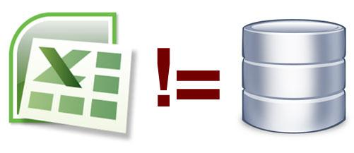
Excel is not a database .

Slide 32
UNIT 2: RELATIONAL QUERY LANGUAGES
Relational Algebra
Data Definition Language
Data Manipulation Language
Data Control Language

Slide 33

SQL
What does SQL stands for ?

Slide 34


ALSO SQL !!
A standardised programming language which is used for managing relational databases
With SQL you can modify databases , add, update or delete rows of data, retrieve subsets of information from a database
Queries and other SQL operations are written as statements.

Slide 35






WHICH DATABASES USE SQL?

Slide 36

UNIT 3: RELATIONAL DATABASE DESIGN
Relational database design (RDD) models information and data into a set of tables with rows and columns. Each row of a relation/table represents a record, and each column represents an attribute of data.
The design of a relational database is composed of four stages, where the data are modeled into a set of related tables. The stages are:
Define relations/attributes
Define primary keys
Define relationships
Normalization

Slide 37

UNIT 4: DATABASE TRANSACTION PROCESSING
What happens when you send 1000 rs to your friend and he has not received it??

Slide 38
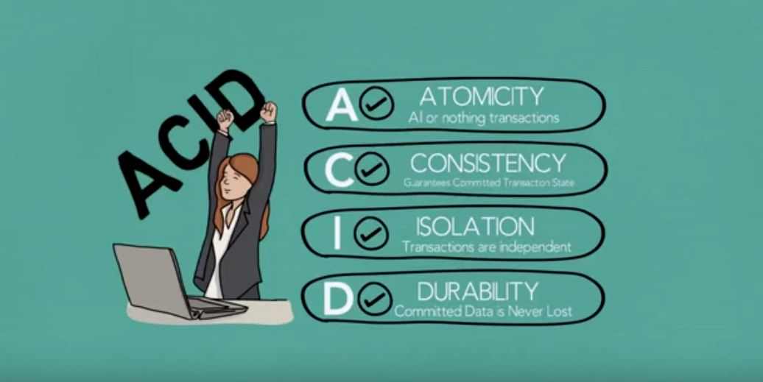
DON’T WORRY! ACID PROPERTIES SAVE THAT

Slide 39
UNIT 5: PROGRAMMING CONSTRUCTS IN DATABASES
You will study
Flow control statements
Functions
Stored Procedures
Cursors
Triggers
Exception Handling

Slide 40
UNIT 6: FILE ORGANIZATION AND TRENDS IN DATABASES
File Organization refers to the logical relationships among various records that constitute the file, particularly with respect to the means of identification and access to any specific record
In simple terms, Storing the files in certain order is called file Organization.
File Structure refers to the format of the label and data blocks and of any logical control record.

Slide 41

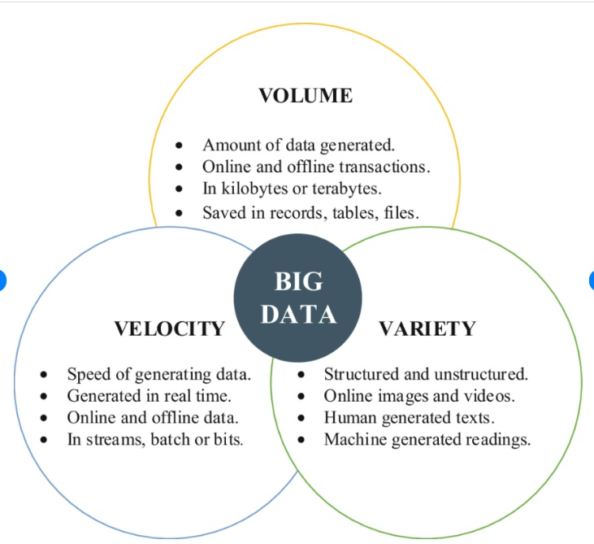
Big data is data that contains greater variety arriving in increasing volumes and with ever-higher velocity. This is known as the three Vs.
The 3 V’s of Big Data
Volume
Velocity
Variety

Slide 42
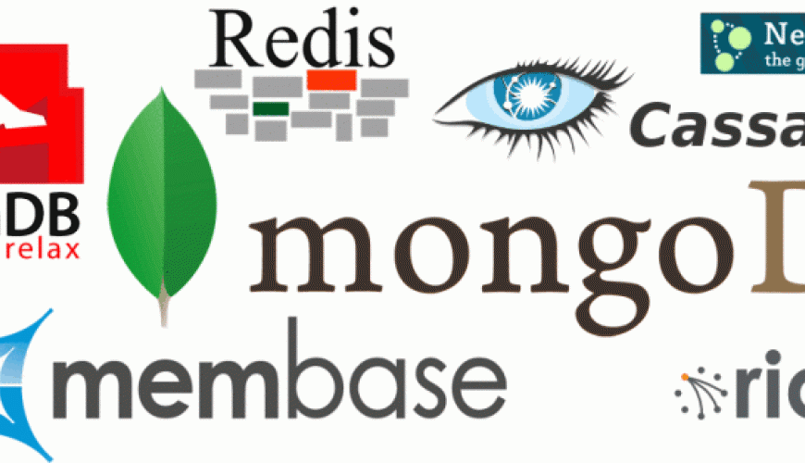
NOSQL- NOT ONLY SQL

Slide 43
MOOCs (Massive Open Online Courses) or Industry certification
Details of MOOC Provider | MOOC Name | Online Link for MooC
Swayam | Database Management System | https://onlinecourses.nptel.ac.in/noc23_cs29/preview
Great Learning | SQL for Data Science | https://www.mygreatlearning.com/academy/learn-for-free/courses/sql-for-data-science
Udemy | Database Management Systems | https://www.udemy.com/course/database-management-system/

